Slide 1
Using WebSockets with ColdFusion
Raymond Camden | Developer Evangelist
Twitter: @cfjedimaster

Slide 2

Who am I?
Raymond Camden
Developer Evangelist for Adobe
www.raymondcamden.com
@cfjedimaster

Slide 3
What the heck is a Web Socket?
Notes:
Designer?
Developer?
Both?
jQuery?
jQuery Mobile?
PhoneGap?
TypeKit?
Adobe Edge?

Slide 4
"WebSocket is a web technology providing for multiplexing bi-directional, full-duplex communications channels over a single TCP connection. "
-Wikipedia

Slide 5
No, seriously, what is it?

Slide 6
WebSockets are a way to create JavaScript applications that have a true, open, connection to the server. This means they can receive updates instantly and broadcast to other clients.

Slide 7
Ok, dude, what?

Slide 8
setInterval(checkForStuff, 2000);
function checkForStuff() {
someAjaxCallToTheServer();
}
Notes:
THe biggest thing wrong with this is the waste of network calls. If your server doesn't have data for you then you've just wasted it.
If you slow it down, then you run the risk of your data being out of date.

Slide 9
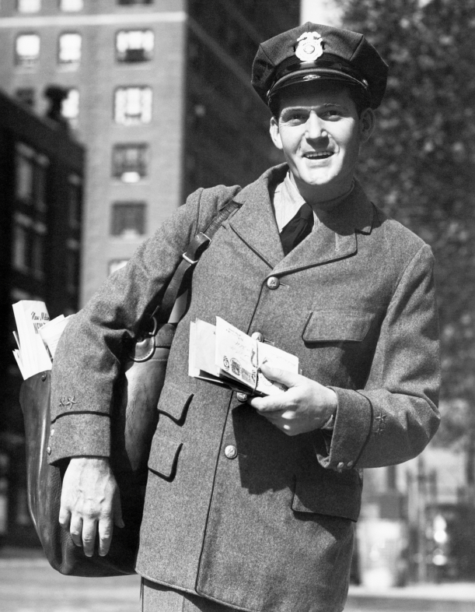
Remember this guy?

Slide 10
The New Hotness
Allow me to open a connection
I'm told when new stuff is broadcast (server or other clients)
I can broadcast my own stuff
All kinds of fun filtering/organizing possible (think switchboard)

Slide 11

Communication via Phone

Slide 12
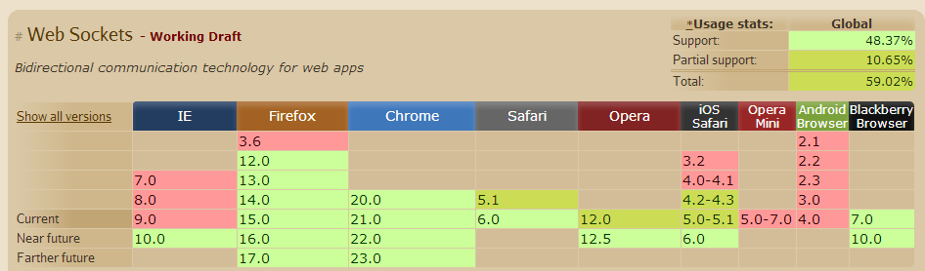
Is your browser cool?
Notes:
When I first wrote this, support was at 43.8%.

Slide 13
!websocket
Fallback to Flash
100% of your code still works
Support for showing a message to the poor saps left out…

Slide 14
The Details
Client side and server side
ColdFusion tags and JavaScript
You will be writing JavaScript

Slide 15
Step One
Application.cfc defines valid channels
Channels are the most broad, most high level organization for WebSockets
Defined as an array of structs

Slide 16
Example
this.wschannels = [{name="Sports"},
{name="Stocks"},
{name="Weather"}];

Slide 17
Step Two
Your CFM defines a websocket via the new <cfwebsocket> tag
Give it a name that sets up the JavaScript handle
Tell it what to run when a message comes in
Tell it what channel to connect to
(There's more options)

Slide 18
Example
<cfwebsocket name="myWS"
onMessage="messageHandler" subscribeTo="news">

Slide 19
Demo
/example1

Slide 20
Using the JavaScript API
publish - send a message (anything!)
openConnection/closeConnection - pick up or hang up the phone
subscribe/unsubscribe - connect (or disconnect) from a channel
getSubcriptions - what I'm subscribed to
getSubscriberCount - how many people are listening

Slide 21
More…
authenticate - used for secured channels
invoke and invokeAndPublish - used to communicate to a CFC

Slide 22
Demo
/example2

Slide 23
CFC Handlers
Give you server-side control over your websockets
Must extend CFIDE.websocket.ChannelListener
Some map to JavaScript functions
Define the use of a handler in your Application.cfc
Cached!!

Slide 24
Methods
allowSubscribe - can I join the party?
allowPublish - can I say something?
beforePublish - format the message
canSendMessage - can I hear something?
beforeSendMessage - client specific formatting/modification
afterUnsubscribe

Slide 25
Demo
/example3

Slide 26
Server-Side Functions
wsGetSubscribers(channel)
wsPublish(channel, msg)
wsGetAllChannels

Slide 27
Demo
/example4

Slide 28
Filtering Options
Multiple Channels
News, Weather, Sports, and Beer
Manual processing
Messages can include custom data
Subchannels
Selectors

Slide 29
Subchannels
You must subscribe to a channel defined in App.cfc, ala "news"
But you can subscribe to a "dot path" under this: "news.sports"
And go as far as you want: "news.sports.american.football"

Slide 30
Subchannels (2)
You get messages for your subscription and "lower" nodes.
Subscribed to news and you get news, news.sports, news.tech
Subscribed to news.sports, you won't get news or news.tech
Subscribed to news.sports, you will get news.sports.football

Slide 31
Demo
/example5

Slide 32
Selectors
Allow for more precise targeting
Applies to publishing/receiving
Selector is a basic conditional
property <some comparison> value
ColdFusion expressions, not JavaScript (no < or >)

Slide 33
Selector Example
Ch: Products, Selector: price lt 100
Ch: Stocks, Selector: change gt 10
Ch: Scores, Selector: sport eq 'football'

Slide 34
Demo
/example6

Slide 35

Security

Slide 36
Authentication
Via onWSAuthenticate and JavaScript code (in other words, login with your fancy WebSocket app)
Via an existing login, but cflogin only

Slide 37
onWSAuthenticate
New method of Application.cfc
Passed username, password, connectionInfo
connectionInfo is a struct you modify
must set .authenticated=true at minimum
In JavaScript, use authenticate method
Note! CFC handler MUST check in allowSubscribe

Slide 38
Demo
/example7

Slide 39
SingleSignOn Mode
Basically, this mode works with an existing authenticated user
Must work along with cflogin-based security

Slide 40
Demo
/example8

Slide 41

Security
Remember - your WebSocket JavaScript variable is manipulable
Show the console hack in chat
This is all as secure as any other Ajax application

Slide 42

No Chat Demo!

Slide 43
invokeAndPublish
Used to run an adhoc CFC server to generate a message on a channel
Usage: myWS.invokeAndPublish("channel", "cfcname", "method", arrayOfArgs, structOfCustomHeaders)
Also runs allowPublish() in your CFC handler
Cached

Slide 44
Demo
/example9

Slide 45
Point2Point WebSocket
Just you and the server (oh, how sweet)
No channels involved - just a server CFC
CFC can return messages, and make new ones via wsSendMessage

Slide 46
Demo
/example10

Slide 47
Fallback
If no websockets…
Use Flash…
If no Flash…
messageHandler gets something
or you can use onError

Slide 48
Demo
/example11

Slide 49
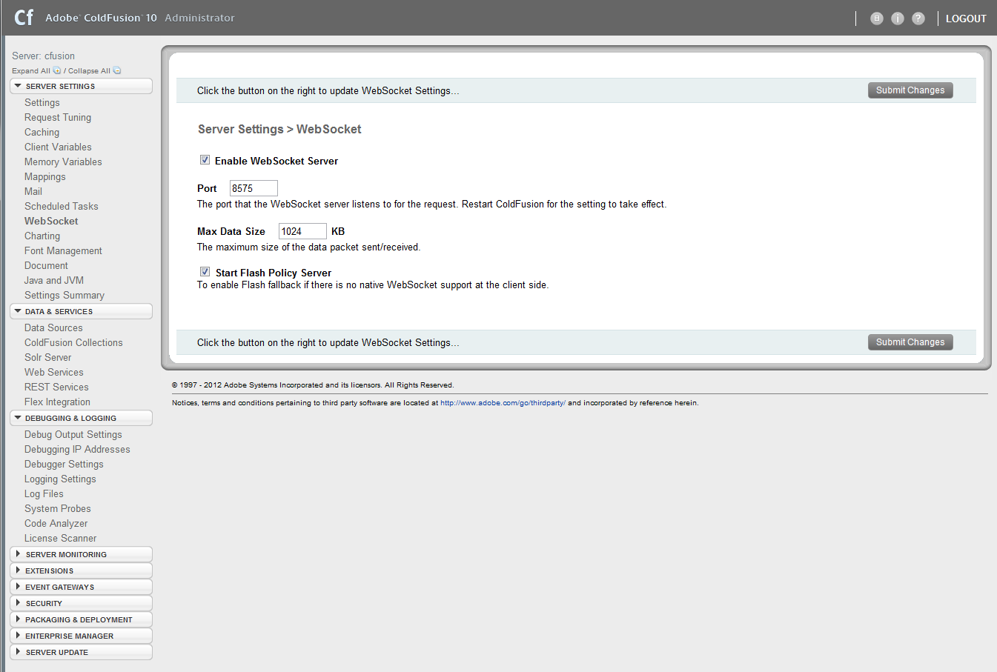
CF Administrator Options
Global enable/disable
Set port and max data size
Enable Flash fallback

Slide 50
Chrome Dev Tools
Just show it…

Slide 51

Any questions?

